Slide 1
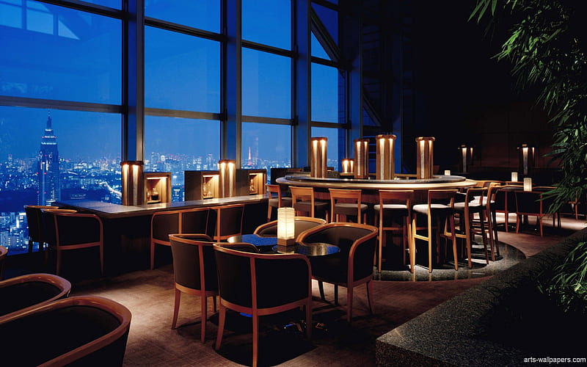
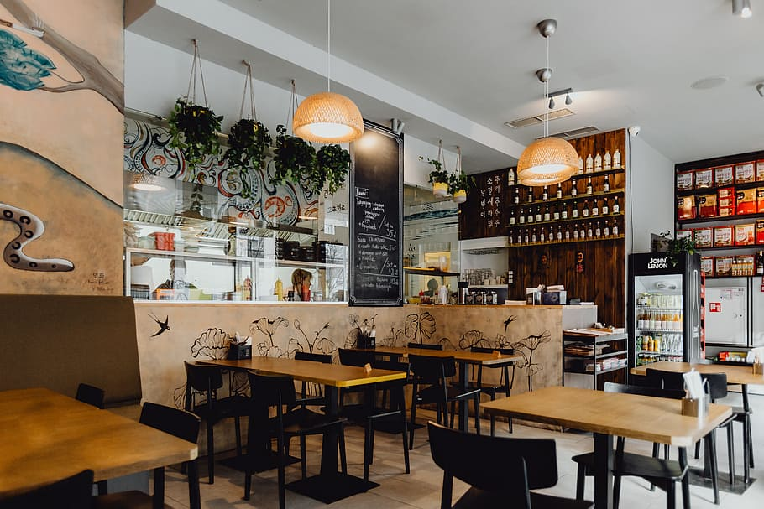
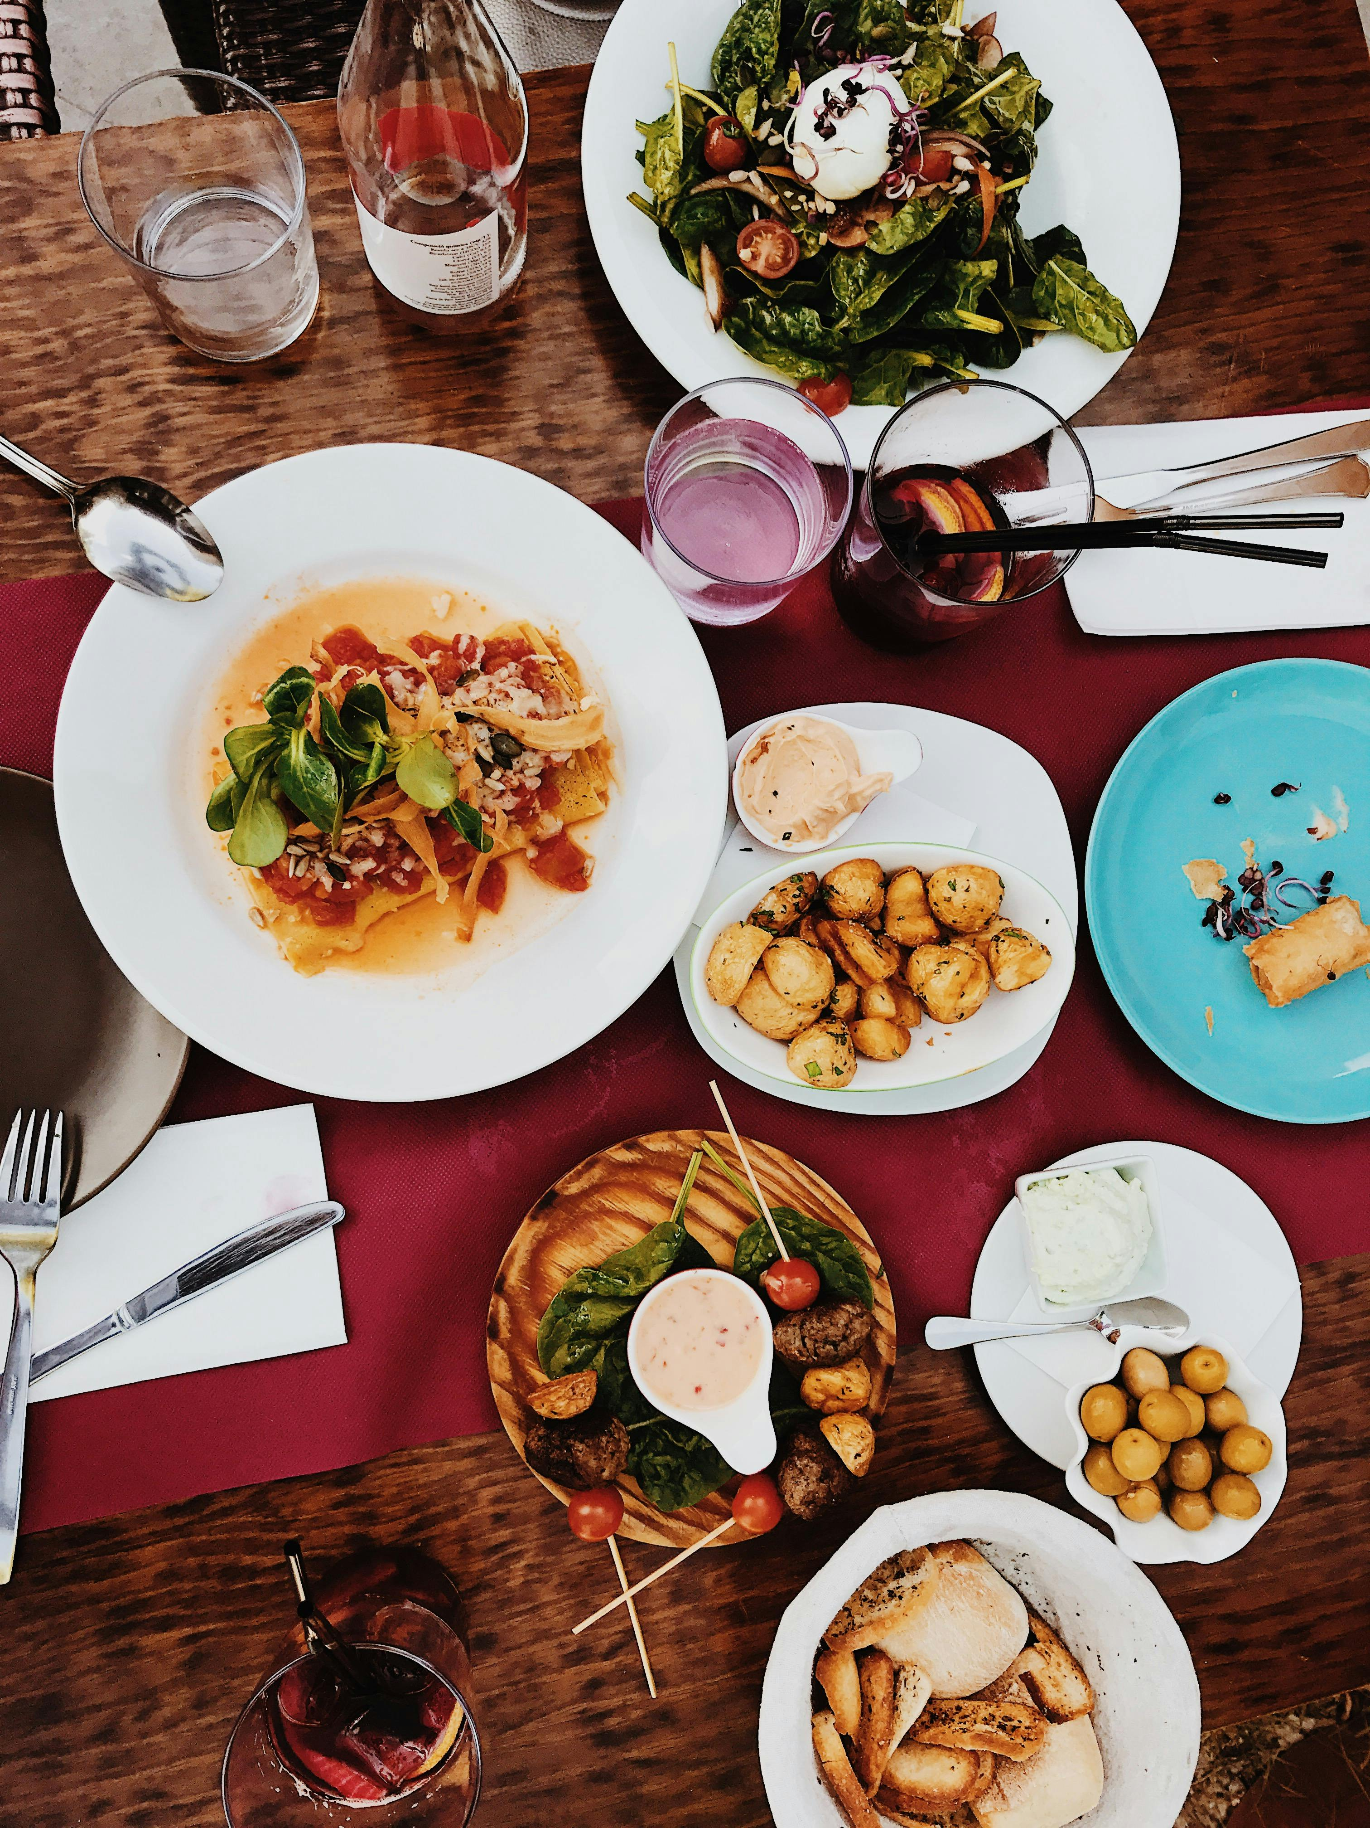
Restaurant Recommendation System

Slide 2

Dr.J.J.Magdum, Trust’s Dr.J.J.Magdum, College of Engineering,Jaysingpur
Department of Computer Science and Engineering
Student Name | Roll No
Yogesh Yashvant Dapale | 59
Pratik Sanjay Farakte | 60
Azhar Gadad | 61
Milind Sanjaykumar Hodagepatil | 62
Yogesh Balkrishna Mudalkar | 63
Project Guide: Prof. R. D. Mane

Slide 3
Contents
Introduction
Abstract
Problem statement
Architecture Diagram
Literature Review
Necessity of Work
Methodology
Hardware and Software Requirements
Conclusion

Slide 4
Introduction
The proposed topic for this project report centers around the development of a Restaurant Recommendation System.
a cutting-edge solution designed to revolutionize the dining experience for individuals in an increasingly dynamic and diverse culinary landscape.
In today's fast-paced world, people are often faced with the daunting task of choosing a restaurant f rom an overwhelming number of options, each offering a unique dining experience.
This recommendation system aims to streamline the decision-making process by harnessing the power of data analysis and user preferences to provide personalized restaurant suggestions.
The motivation behind selecting this topic is rooted in the growing importance of technology in shaping consumer choices and enhancing user experiences.

Slide 5
Abstract
The growing abundance of dining options in today's bustling cities has led to an increasingly daunting task for diners - selecting the perfect restaurant that suits their preferences and cravings. To address this predicament.
we propose the development of an innovative restaurant recommendation system. Our project aims to revolutionize the way people discover dining establishments by harnessing the power of data analytic and machine learning.
By aggregating and analyzing a vast array of data, including user reviews, ratings, cuisine types, location, and personal dining history.
our recommendation system will provide personalized dining suggestions to users, helping them make informed decisions

Slide 6
Problem statement
Dining out is a common practice, but the sheer number of restaurant choices can overwhelm customers. To address this challenge, we aim to create a high-tech restaurant recommendation system.

Slide 7
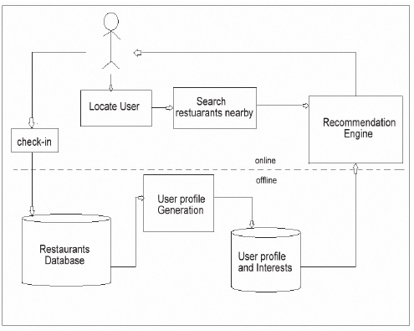
Architecture diagram

Slide 8
Methodology
1. Data Pre-processing Module:
Input Data Needed:
Source of Data:
Data Collection and Processing:
2. Development Module:
Data Analysis and Modelling:
Behaviour Profiling:
3. Training and Testing Module:
Parameters and Methods:
Testing Strategies:
Validation and Deployment:

Slide 9
Literature Review
COMPARATIVE ANALYSIS OF RESEARCH PAPERS
S.No | Author Name | Date | Description
1. | Park and H. Kim | 2017 | Hybrid Restaurant Recommendation System Using Deep Learning and Collaborative Filtering
2. | A. Gupta and R. Verma | 2018 | A Content-Based Restaurant Recommendation System" by M. Chen and L. Zhang
3. | J. Lee and S. KimS | 2019 | A Collaborative Filtering Recommendation Algorithm for Restaurants
4. | A. Gupta and R. Verma | 2020 | Location-based recommendation system that employs deep learning techniques.

Slide 10
Necessity of Work
1.Improved Data Efficiency
2. Scalable Solutions
3. Effective Cold-Start Handling
4.Make System Location Based
5. Enhanced Data Quality and Accuracy
6. Real-Time Processing Optimization

Slide 11
Hardware and Software Requirements
Hardware Requirements:
Processor: Preferably 1.5 GHz or Greater.
RAM: 4GB or Greater.
Software Requirements:
Visual Studio Code
Python 3.8.0
Installation of Python Libraries (pandas , numpy , matplotlib )

Slide 12
Conclusion
In this project, we developed a web app which recommend the restaurant based on the choice of your interest. This is used for the users to predict the suitable and best restaurant as per their tastes. The content based filtering and collaborative based filtering makes the recommendation more efficient so that each user can use this application for their easy prediction of restaurant.
The project Restaurant Recommendation System was successfully completed by using latent factor collaborative filtering or matrix factorization. In this project, we developed a model that could recommend the restaurant based on the choice of interest.

Slide 13
Thank you.

